Slide 1


Final Year Project
Computer On Wheels
Supervised By: Dr. Naveed Ikram(Professor)

Slide 2
Project Team
Bilal Rafiq (27661)
Hamza Azhar(28595)
Sardar Mohsin (28016)
M. Usama Nazir (30445)

Slide 3
Table of Content
Opportunity & Stakeholders
Existing Systems
Problem Statement
Endeavour (Team + Work + Way of Working)
System
Requirements Summary
Design Summary
Implementation Summary
Testing & Evaluation Summary
Conclusion and Outlook

Slide 4
Opportunity & Stakeholders

Slide 5
Opportunity(1/3)
According to a National Highway Traffic Safety Administration (NHTSA) study, driver error led to 94% of the crashes examined.
According to the U.S. General Services Administration (GSA), human error causes 98% of crashes.

Slide 6
Opportunity (2/3)
A 2017 study by RAND Corporation found that self-driving cars could reduce traffic fatalities by up to 25% by 2040.
A 2019 study by the National Highway Traffic Safety Administration (NHTSA) found that self-driving cars were involved in fewer crashes than human-driven cars per mile driven.
A 2020 study by the Massachusetts Institute of Technology (MIT) found that self-driving cars could prevent up to 90% of crashes caused by human error.

Slide 7
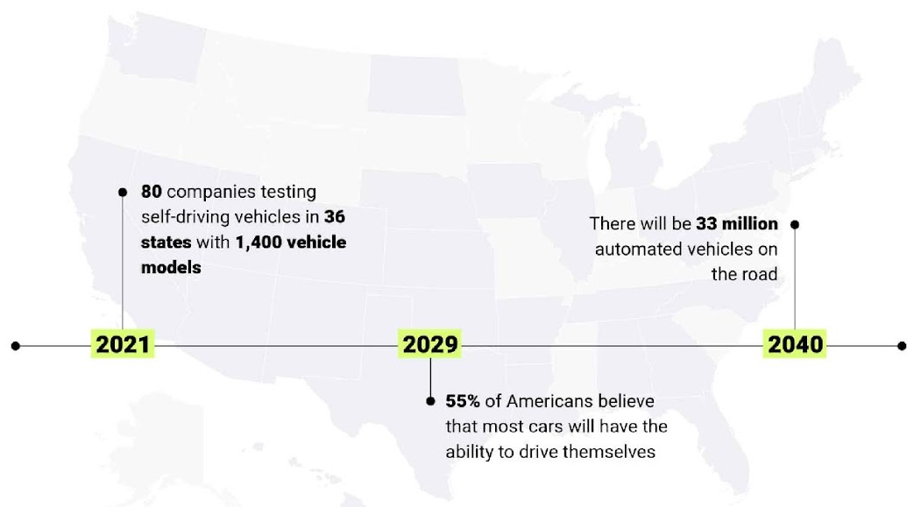
Opportunity (3/3)

Slide 8
Stakeholders
Driver/Car
Passengers

Slide 9
Existing systems

Slide 10
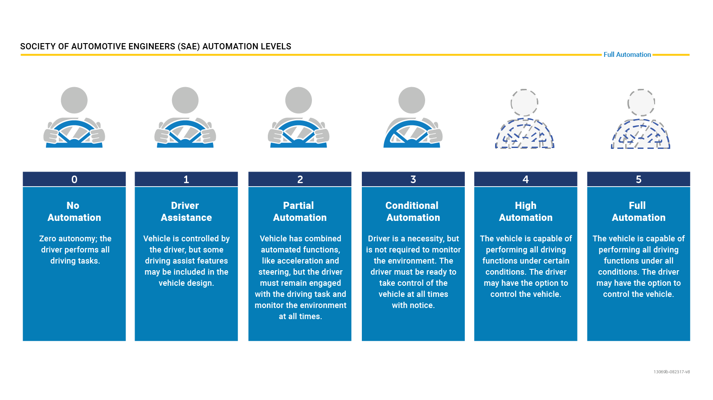
Levels of Autonomous Vehicle
Notes:
The Society of Automotive Engineers (SAE) International has defined six levels of driving automation, ranging from Level 0 (no automation) to Level 5 (full automation). As of today, only Levels 0, 1, and 2 are commercially available in production vehicles.

Slide 11
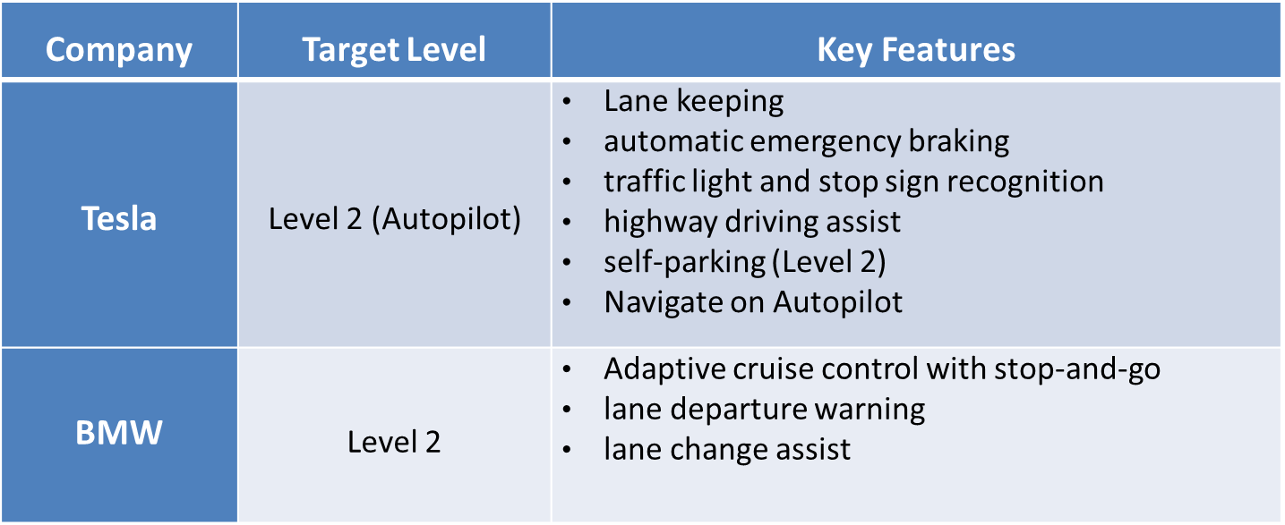
Existing Systems (1/2)
Notes:
As of early 2024, no commercially available vehicles are fully autonomous, but many automakers are developing Level 4 and Level 5 vehicles.
As of March 5, 2024, commercially available vehicles primarily fall under Level 2 on the SAE International's J3016 classification system for automated driving. This signifies that they offer advanced driver assistance systems (ADAS), but not full autonomy.
While some companies, like Honda, Mercedes-Benz, BMW Group, and Kia, have received approvals for Level 3 vehicles in specific regions, these are still in limited deployment and not widely available to the public. Level 3 allows for conditional automation under certain conditions, where the driver can take their eyes off the road for brief periods.

Slide 12
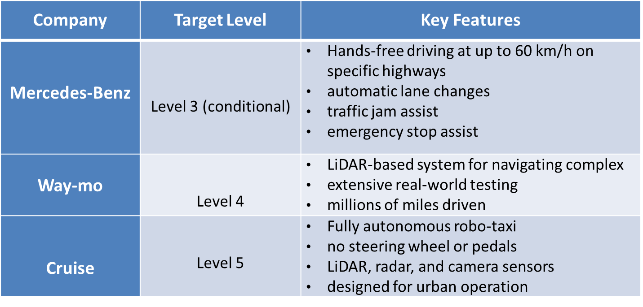
Existing Systems (2/2)
Notes:
Tesla, BMW: Path Planning and following:
employ a variety of path planning algorithms, including:
Graph search:
Probabilistic roadmaps (PRMs)
Learning-based methods
Model predictive control
Obstacle Detection and Avoidance:
not publicly known (DEEP MACHINE LEARNING)
Mercedes (no disclosed)
Waymo and cruise doesn't disclose the specific algorithms they use but use High-definition (HD) maps: These detailed maps provide information about the environment, including lane markings, traffic signals, and points of interest. The system can leverage these maps for path planning within the designated areas.

Slide 13
Problem Statement

Slide 14
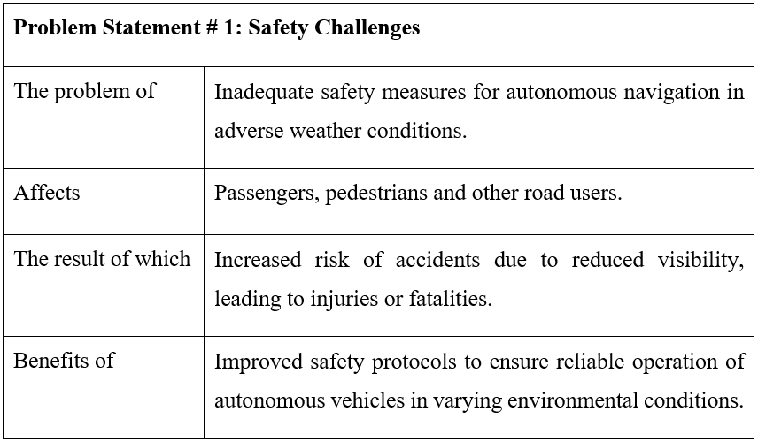
Problem Statement(1/3)

Slide 15
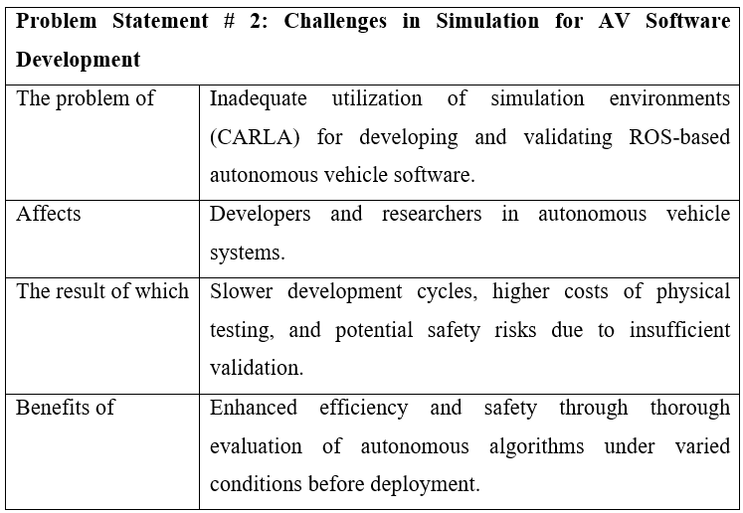
Problem Statement(2/3)

Slide 16
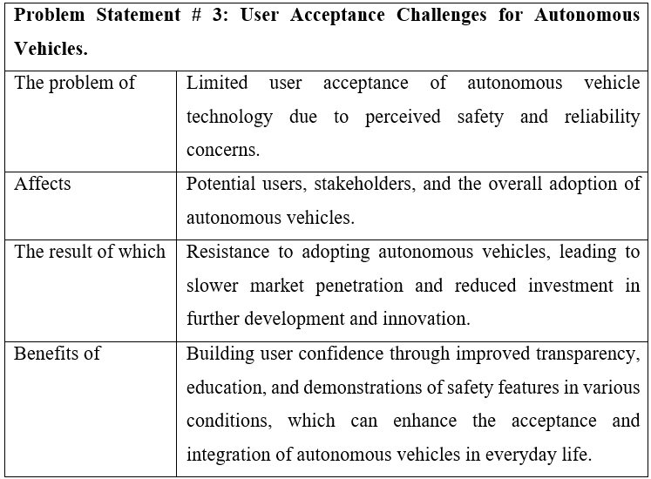
Problem Statement(3/3)

Slide 17
Endeavour

Slide 18
Endeavour
Describe roles of your team members
Describe your software development process
Describe your way of working as a team

Slide 19
Software Development Process
Software Engineering Practice:
In our project, we adopted the Waterfall model, providing a structured and disciplined approach to software engineering that aligns with the linear nature of embedded software development for autonomous vehicles.
This methodology ensured clear requirements, detailed design, rigorous testing, and comprehensive documentation, all contributing to a reliable, maintainable software system tailored to the specific demands of autonomous vehicle applications.

Slide 20
Software Development Process
Waterfall Model Phases: Our project was organized using the traditional Waterfall model, moving sequentially through each phase with clear deliverables and checkpoints to track progress. Key phases included:

Slide 21
Software Development Process
Waterfall Model Development:
Requirements Gathering and Analysis We initiated our process with an in-depth requirements analysis, defining both functional and non-functional requirements. This phase involved collaboration with domain experts and an extensive review of documentation to ensure that the project’s objectives were thoroughly understood and documented for autonomous navigation in a personal use context.

Slide 22
Software Development Process
Waterfall Model Development:
System design:
In the design phase, we translated our requirements into a detailed system architecture, specifying each module’s functionality and interactions. This design documentation served as a blueprint for the implementation phase, supporting a structured development process that would facilitate maintainability and reliability.

Slide 23
Software Development Process
Waterfall Model Development:
Implementation: With a finalized design, we progressed to the implementation phase, systematically coding each module in line with the Waterfall model’s structured guidelines. Key modules included path planning, obstacle detection, and control, all developed with an emphasis on clean, well-documented code that adhered closely to the project's requirements and design specifications.

Slide 24
Software Development Process
Waterfall Model Development:
Integration and Testing Following implementation, rigorous testing validated each module’s functionality and ensured smooth integration. This phase included unit, integration, and system testing to confirm accuracy, reliability, and safety under real-world conditions, such as adverse weather, obstacle detection, and traffic light recognition.

Slide 25
Software Development Process
Waterfall Model Development:
Documentation and Review Process Adhering to the Waterfall model’s focus on comprehensive documentation, each phase was accompanied by detailed documentation and a review process to ensure quality and readiness for future maintenance:
Phase Sign-Offs: Each phase concluded with formal sign-offs from the project supervisor, guaranteeing that all objectives were met before progressing.
Detailed Documentation: Every requirement, design decision, and test case was meticulously documented, creating a reliable reference for any future maintenance or updates.

Slide 26
Endeavour
Continuous Integration: Regular integration and testing ensured quality and early defect detection.
Collaborative Effort: Teams worked closely to ensure efficient communication and alignment.

Slide 27
Endeavour
Rigorous Testing: Consistent testing and code reviews maintained high standards.
Comprehensive Documentation: Detailed documentation was maintained for transparency and future maintenance.

Slide 28
Endeavour
Way of working as a team
Interviewing Stakeholders
Ad-hoc meetings
Version Control: GitHub
Project Management: Jira Issue Tickets
File Sharing: Google Drive/WhatsApp
Online Meetings: Google Meet
Notes:
Ad-hoc: Ideal for addressing unexpected issues or clarifying doubts that arise during feature development or code reviews.

Slide 29
Endeavour
Way of working as a team
Industry Workspace Collaboration
Feedback from Industry Employees
Interaction with Domain Experts
Knowledge Sharing Sessions
Code Reviews

Slide 30
Endeavour
Way of working as a team
Retrospectives Meetings
Continuous Learning and Development Sessions
Milestone Reviews
Emails
Feedback Loop: Regular Performance Reviews
Notes:
Conduct retrospective meetings at the end of each sprint to reflect on what went well, what didn’t, and how processes can be improved.

Slide 31
Solution
We propose a software which makes the vehicle partially autonomous, featuring path planning(shortest path), path following, obstacle detection, dynamic avoidance for safe navigation in Urban Environment.

Slide 32
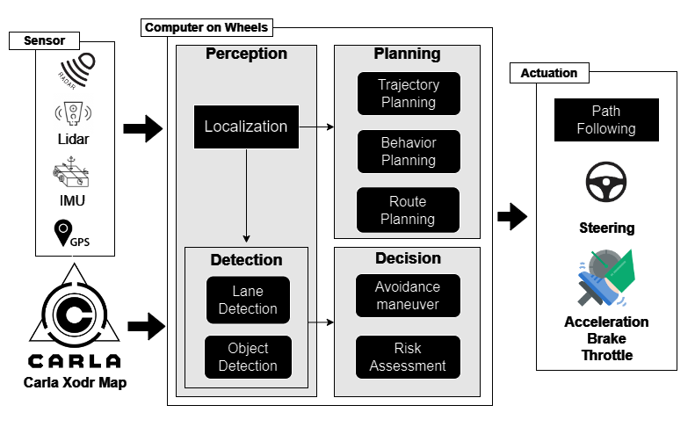
Solution

Slide 33
Requirements
Elicitation Techniques / Tools
Interviewing Domain Expert Interviews
Document Analysis
Notes:
While Interviewing Domain expert we have noted our Questions and created a Questionnaire like which Questions were asked at the time of meeting In Document Analysis we have gathered our requirements through Research articles.

Slide 34
Requirements
Functional Requirements:
There are total 35 Functional requirements. These requirements are Mentioned in SRS and Report.

Slide 35
Requirements
Non-Functional Requirements:
There is only 1 non-Functional requirement in our Project. Which we have gathered and analyzed though Research articles.
Notes:
Based on research paper, we only have this one NFR

Slide 36
Design
Architecture Diagram
Detailed Design:
Use Case Diagram
Sequence Diagram
System State Chart Diagram
Deployment Diagram
Notes:
All based on implemented requirements of part 1 (From architecture to sequence)

Slide 37
Design
Architecture Diagram:
The architecture model that is the best fit for our system and we have designed is based on Layered Architecture Diagram.

Slide 38
Design
Use Cases
There are Total 20 use cases designed for our project these use cases are explicitly shown in our Report.

Slide 39
Testing
SRS => Defect Identification:
Inspection Through Checklist (D1)
System Design => Defect Identification:
Scenario based test cases (D2)
Implementation => Defect Identification:
White Box Testing (D3)
Black Box Testing(D4)

Slide 40
Conclusion and Outlook

Slide 41
Conclusion & Outlook
Conclusion:
Our project successfully demonstrates an embedded autonomous driving system with critical functionalities like path planning, obstacle detection, and traffic light recognition, specifically geared for safe urban navigation.
The project adhered to rigorous software development standards, effectively integrating ROS and CARLA for real-time testing, validation, and performance. This system reduces human-error-related accidents and enhances road safety, proving a foundation for future personal autonomous vehicles.

Slide 42
Conclusion & Outlook
Outlook:
This project could evolve by incorporating advanced sensor fusion for enhanced obstacle detection and more comprehensive path-following capabilities.
Real-world deployment may require adapting the system to varying environments and implementing a higher degree of autonomy. Future efforts can focus on optimizing computational efficiency and expanding the system's flexibility, enabling broader applications in diverse geographic conditions.

